Slide 1
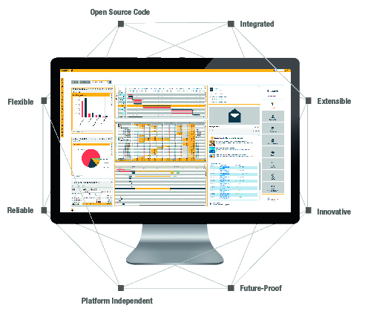
Canias^{ERP}
EDI(Electronic Data Interchange)
Leyla Akmancı
harmancileyla@gmail.com
14.03.2019

Slide 2
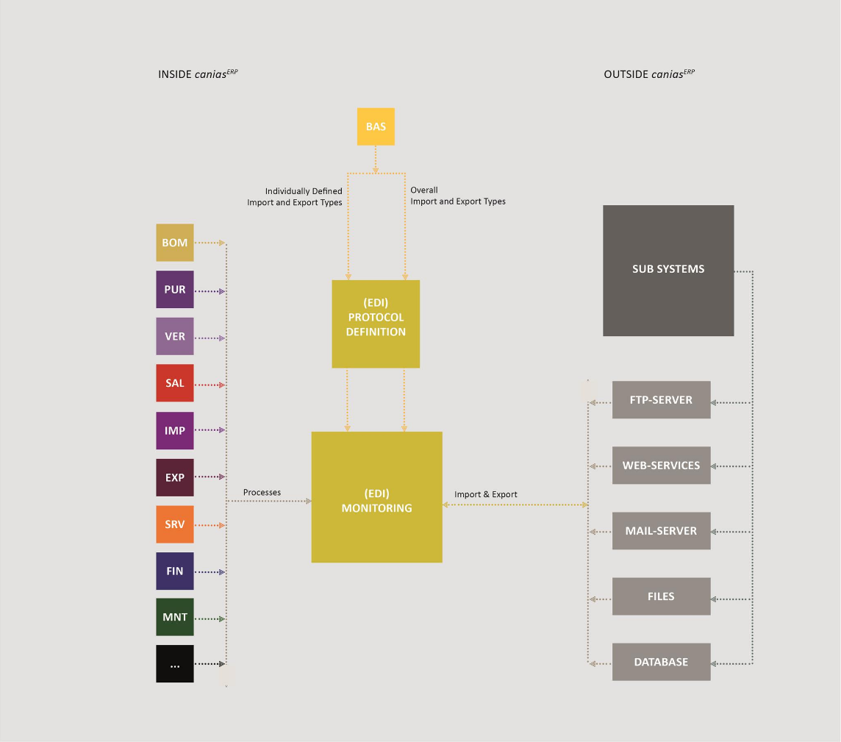

1. Flow Diagram

Slide 3
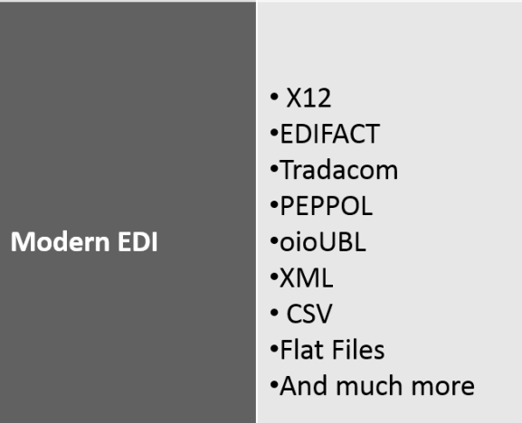
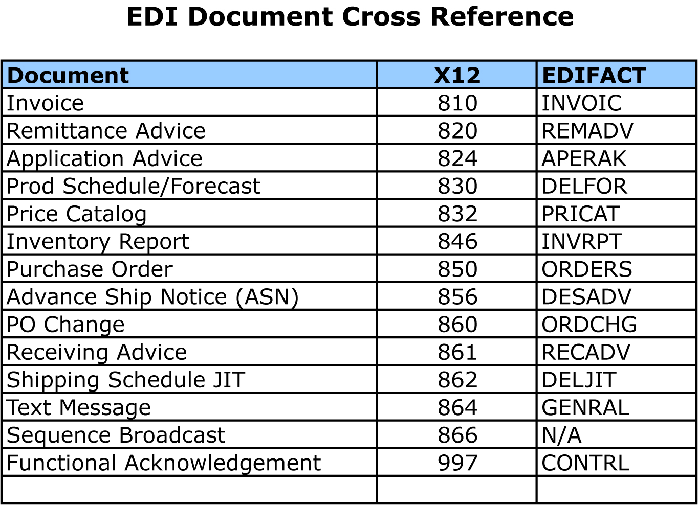

Slide 4
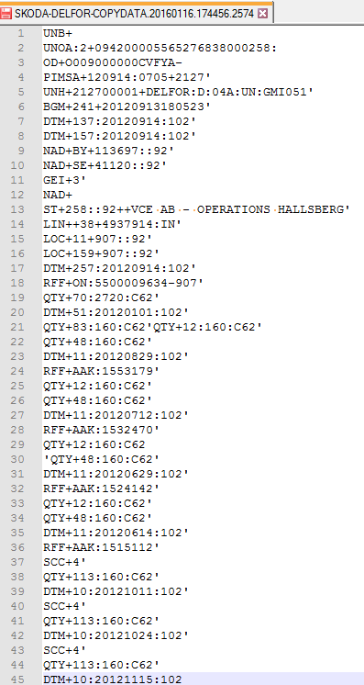
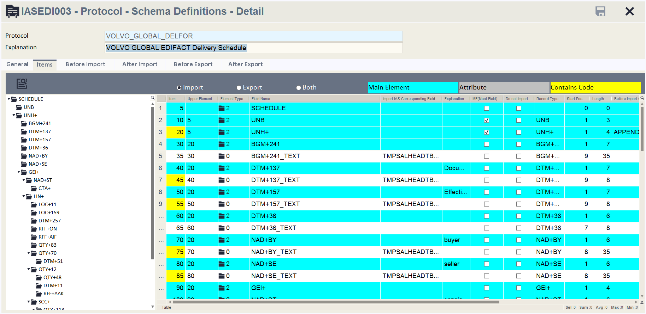

Slide 5
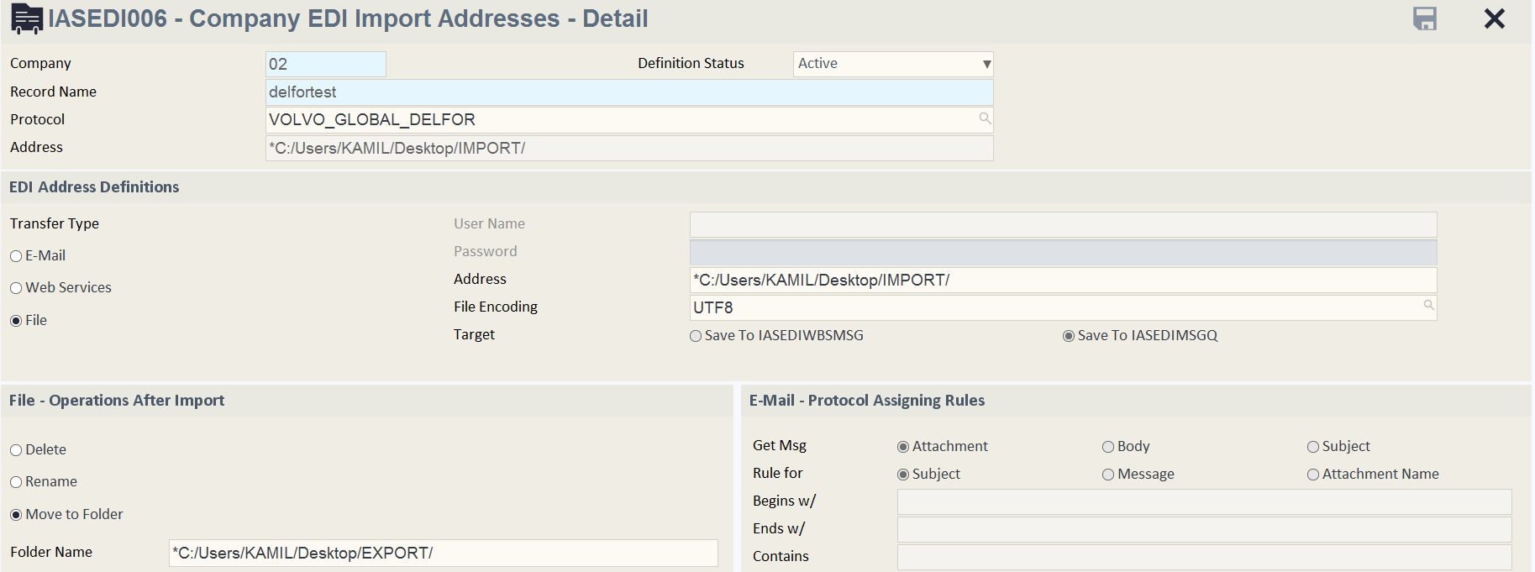

Slide 6
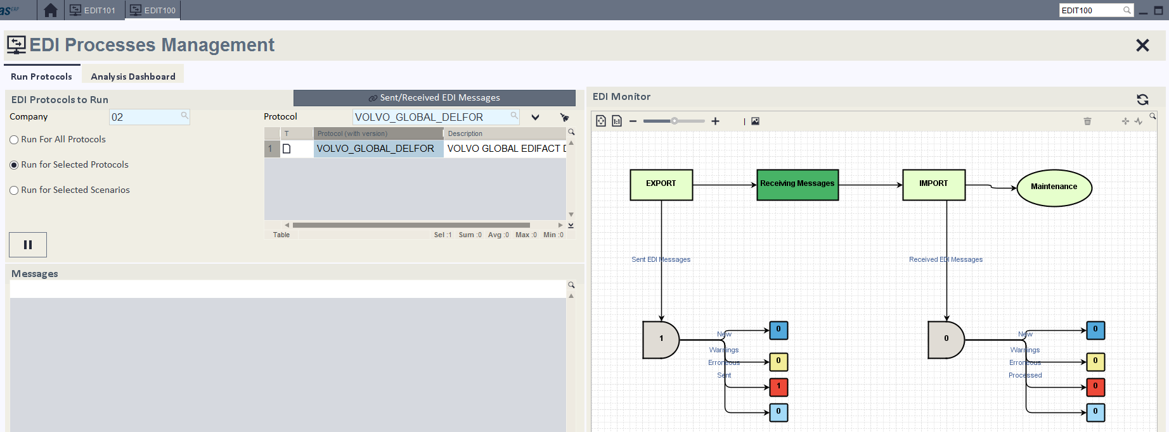
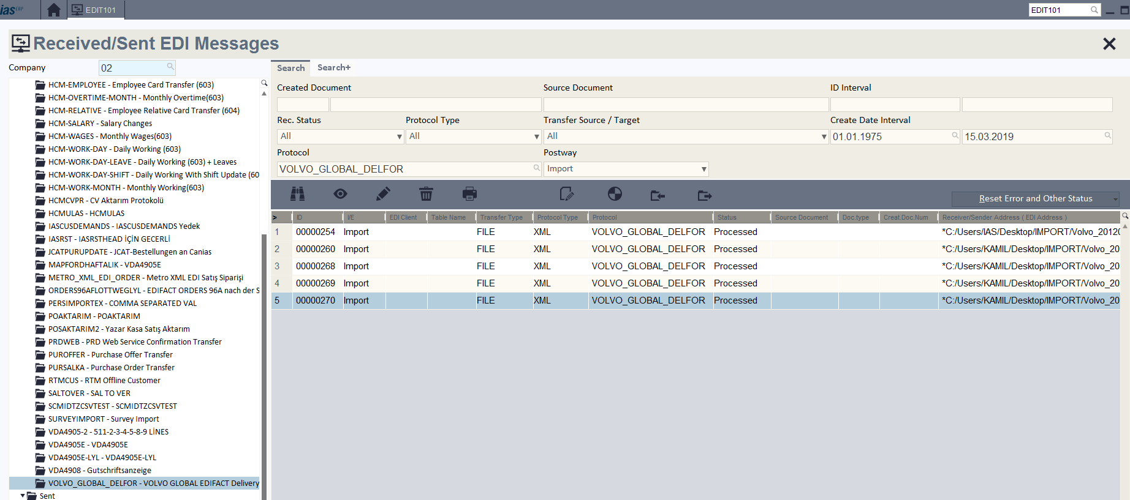
EDIT100 – EDI Processes Management : Run protocol to Export/Import document
EDIT101 – Recieved/ Sent EDI Messages: List of EDI Messages, Manuel Export/Import

Slide 7
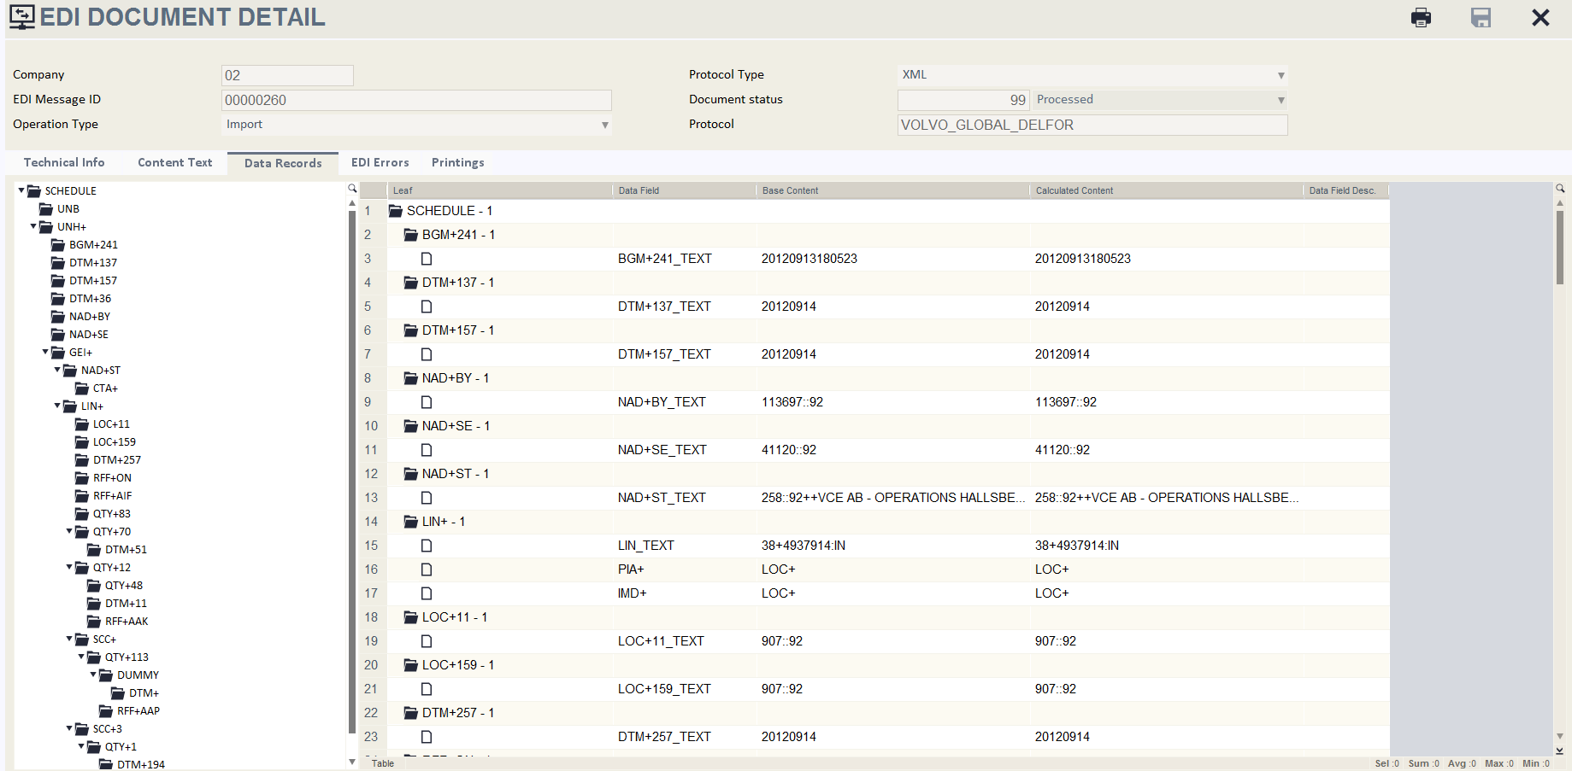
EDIT101 – Recieved/ Sent EDI Messages: EDI Message detail

Slide 8
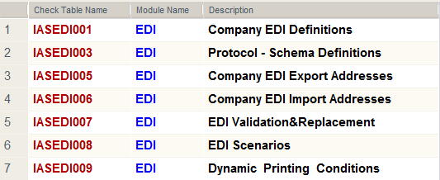
2. Basic Information about Check Tables
-In order to include the data transmitted with different file formats in ERP system, the necessary definitions must be made in the EDI check tables.
-Likewise, the relevant check tables are used to transmit the ERP process data to the desired destination in the desired format.

Slide 9
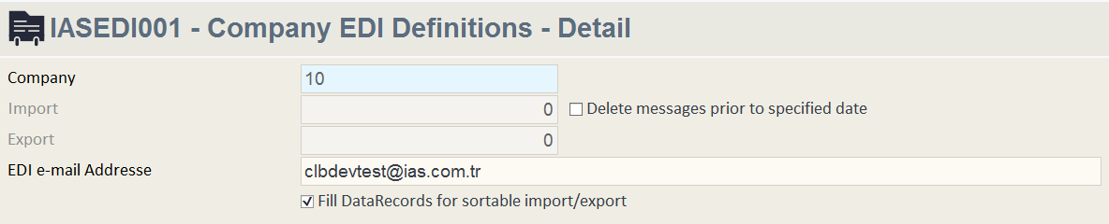
3. IASEDI001 – Company EDI Definitions
* General settings are adjusted for the company in IASEDI001 - Company EDI Definitions checktable
- The EDI mail address is used to determine the sender's address if the message is sent by mail.
-Older messages can be automatically deleted according to the number of days specified for Received / Sent EDI Messages.
-Not the order of message generated of importing / exporting EDI Messages processes, they can be sequentially processed according to the value of any data it contains.

Slide 10
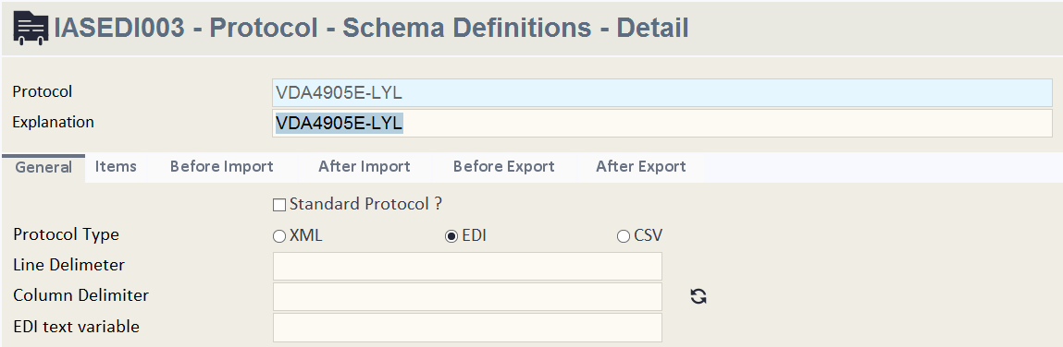
4. IASEDI003 – Protocol Schema Definitions
* EDI Message text format is determined with the IASEDI003 - Protocol - Schema Definitions checktable.(XML, EDI, CSV)
*A protokol can be defined to provide Import and/or Export operations.
*In the Import process, EDI Message text is parsed according to Protocol - Schema Definition items and protocol type.
*In the Export process, the requested process data creates EDI Message text according to Protocol - Schema Definition items and protocol type.

Slide 11
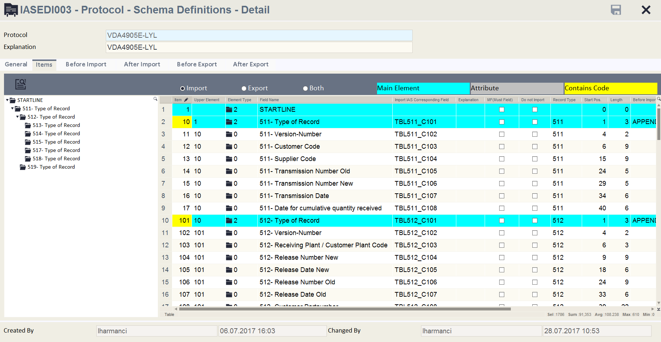
5. Protocol Schema Definitions - Detail
*The layout of the data that creates EDI Message text is specified in IASEDI004 – Table Detail check table.Prefixes and Table Relations (Upper Table, Current Table) is defined.
*canias_table_field can be defined as a field where data is going to be created or data is going to be written.

Slide 12
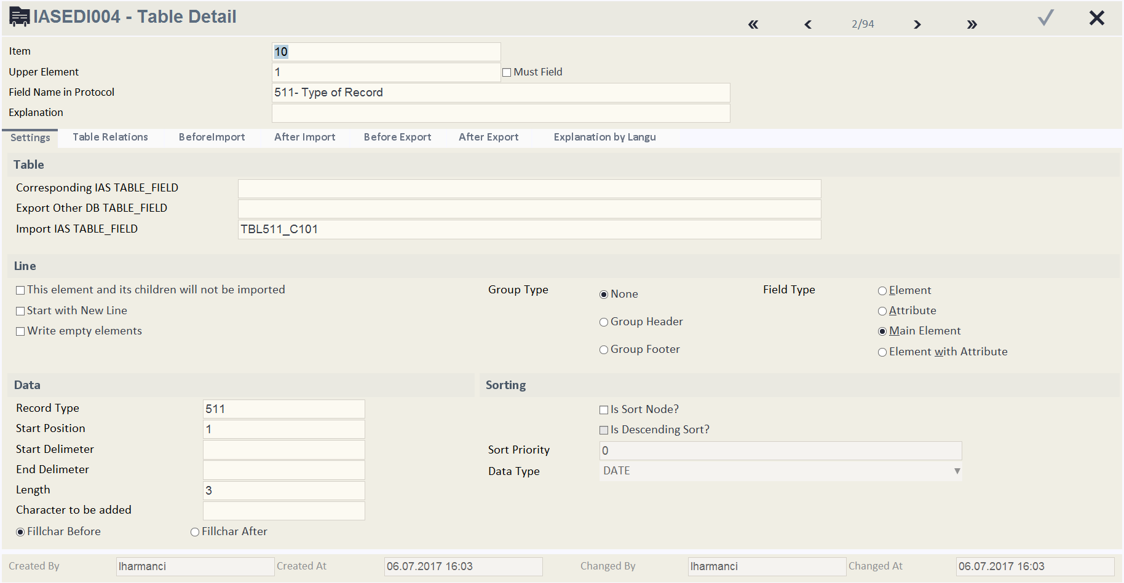
* A necessary settings is made for the data is going be created in Export or going to be parsed in Import process in IASEDI004 – Table Detail screen.
*Is Sort Node? Feature should be selected and Sorting Features can be used if a sorting operation for that item is desired while doing Import/Export process.

Slide 13
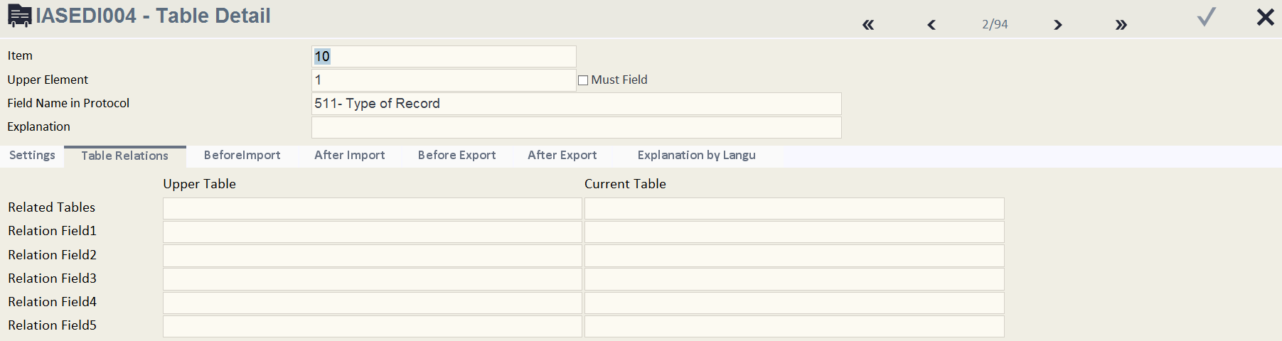
* In Table Relations tab, the fields that creates the relation of two tables can be defined.It is used to maintain the Upper and Current Table relation.

Slide 14
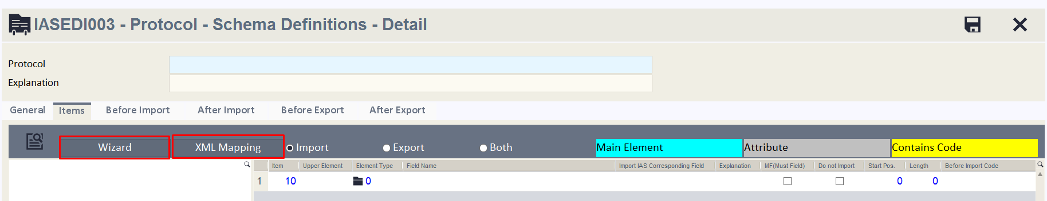
6. XML Mapping , Wizard
''XML Mapping'' feature can be used when creating a new protocol for Importing.''Wizard'' feature can be used to create schema for Exporting Canias Table data.

Slide 15
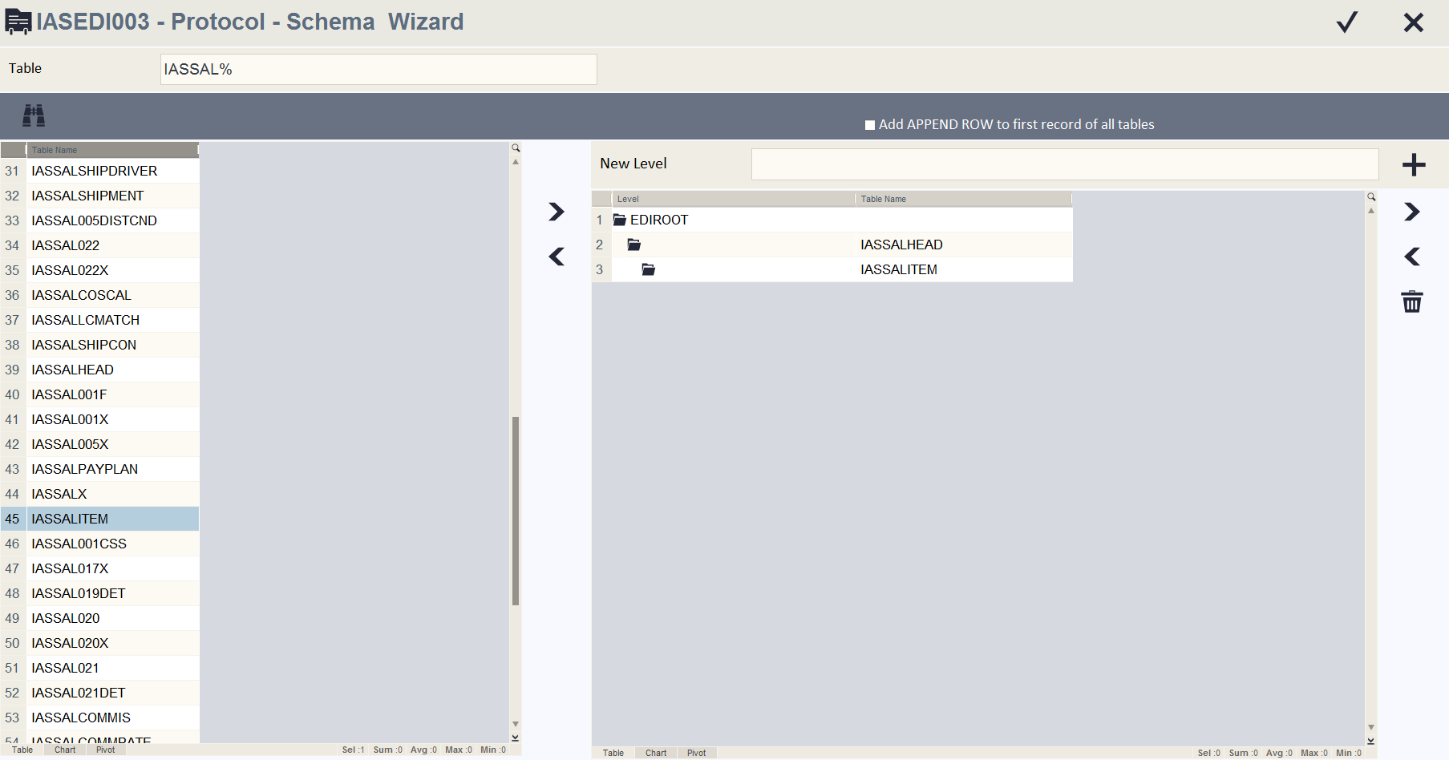
*By pressing the ''Wizard'' button, Protocol – Schema – Wizard screen opens.Desired protocol structure can be created by selecting system tables.Fields of these tables flows as Items.
*Data can be manipulated by writing before/after codes for the protocol.

Slide 16
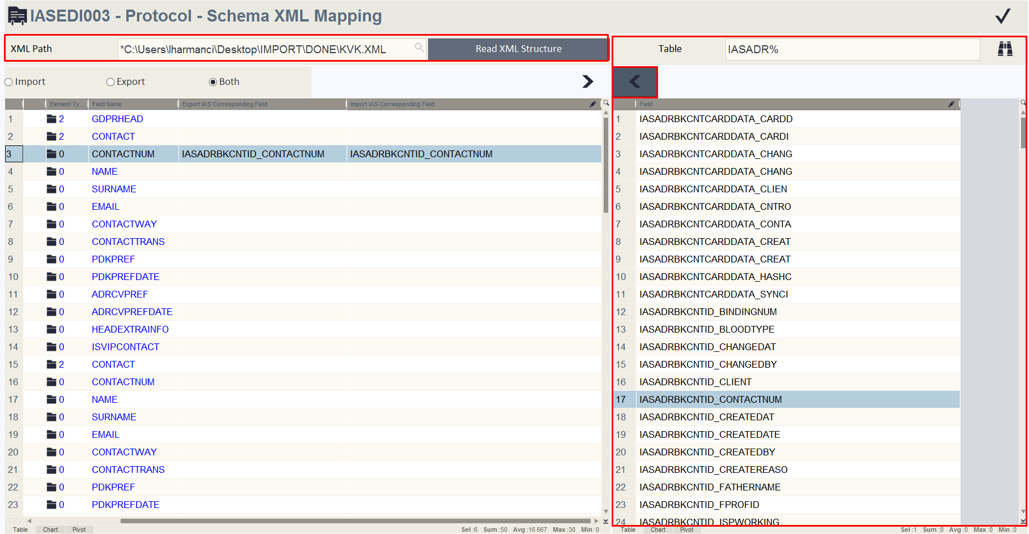
* By pressing the ''XML Mapping'' button, Protocol – Schema XML Mapping screen opens.XML file is selected from XML Path field and then Read XML Structure button is pressed.Protocol structure can be created by parsing XML tags.This XML file's field flows to the protocol as Items. table_field matched for Export/Import can be assigned to item by selecting the list which is located on the right side of the screen.
* Data can be manipulated by writing before/after codes for the protocol.

Slide 17
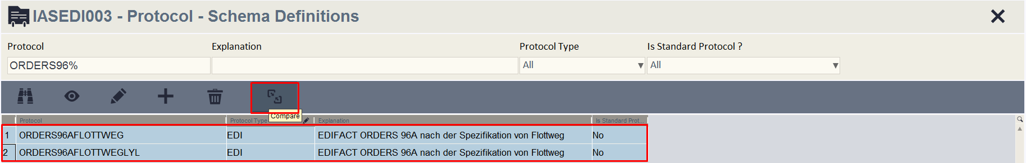
7. EDI Protocol Schema Comparison
* The differences can be examined among the two protocol that created in IASEDI003 checktable by pressing the ''Compare'' button.
*Desired two protocols are selected and ''Compare'' button pressed.

Slide 18
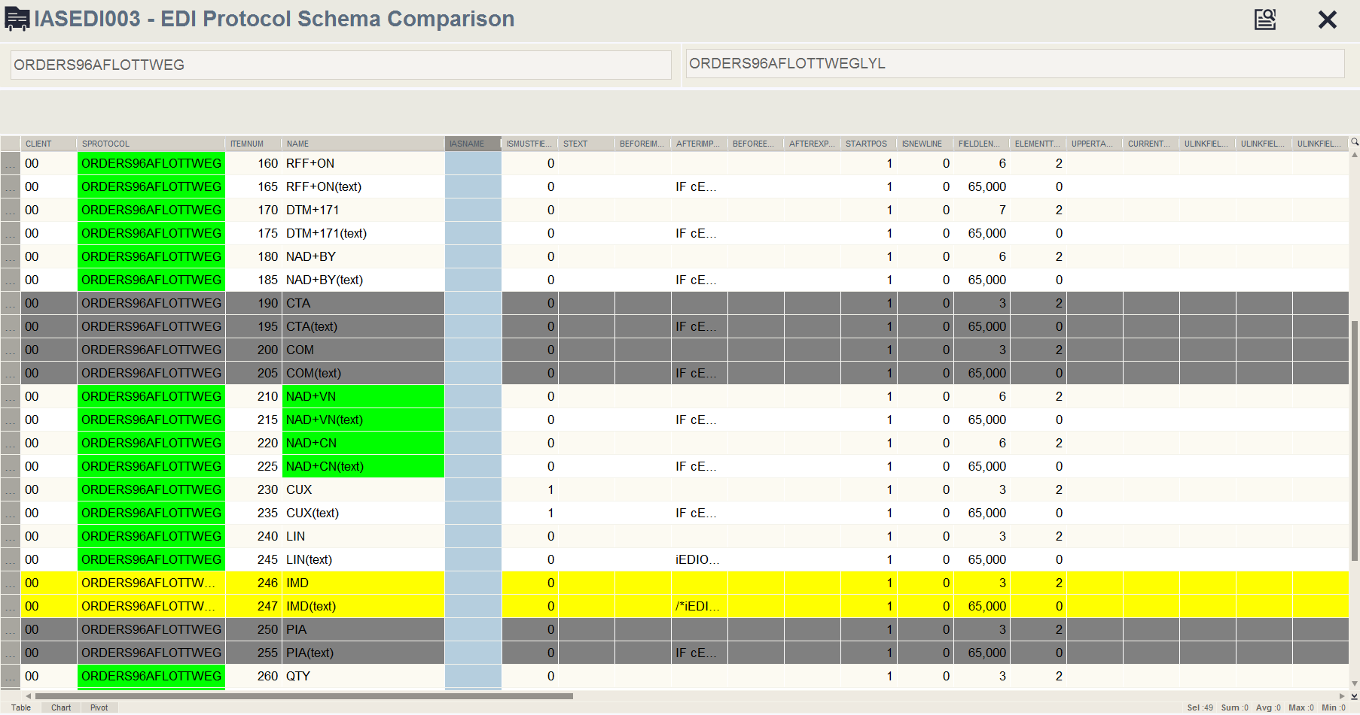
* The items that only exist in first protocol,items that only exist in second protocol and the items that exist for both but having differences in terms of code and settings can be read from compare table.

Slide 19
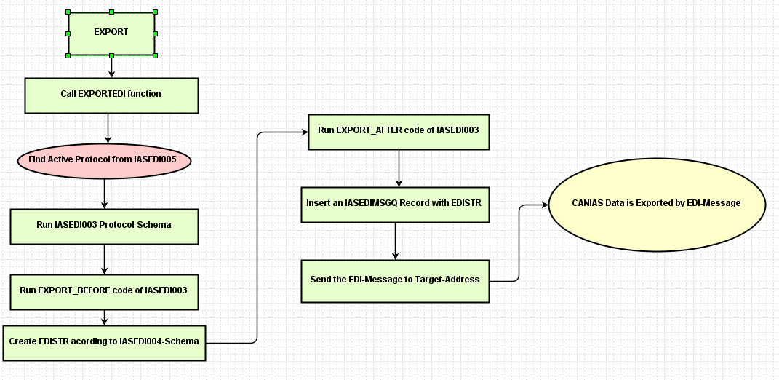
8. Export before/after code Working Principle Diagram

Slide 20
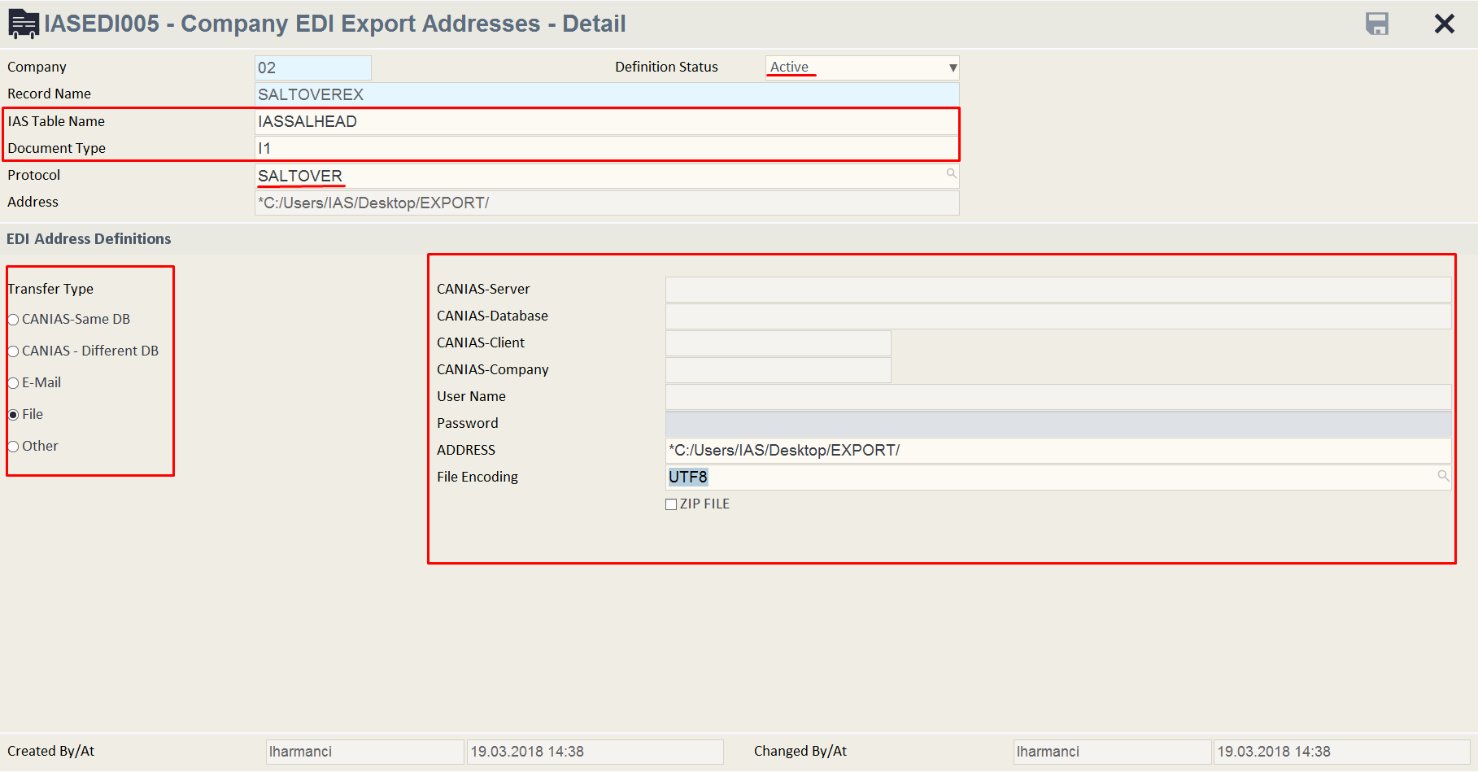
9. IASEDI005 – (Company EDI Export Addresses)

Slide 21
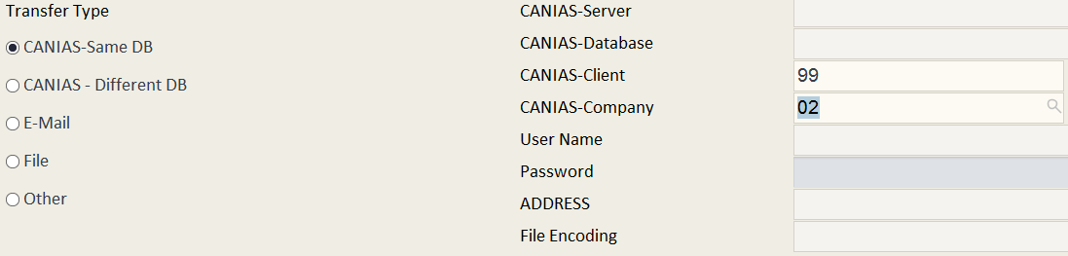
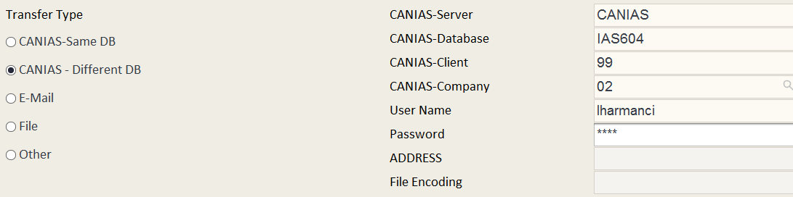
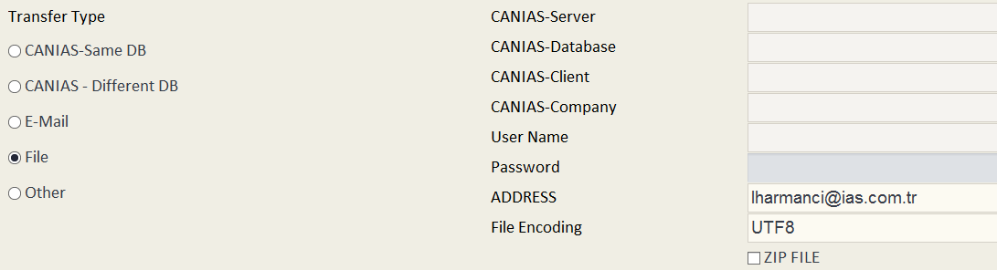

Slide 22
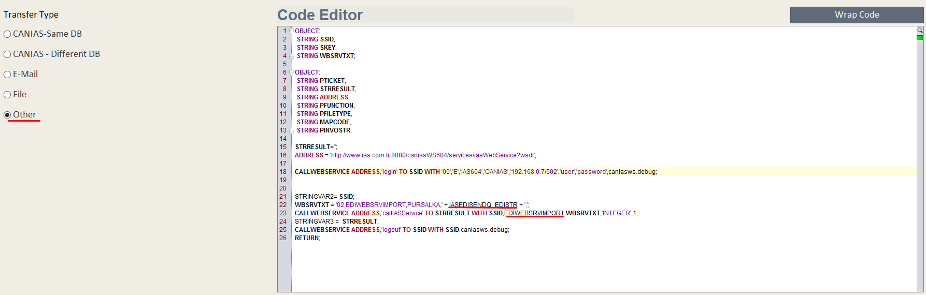

Slide 23
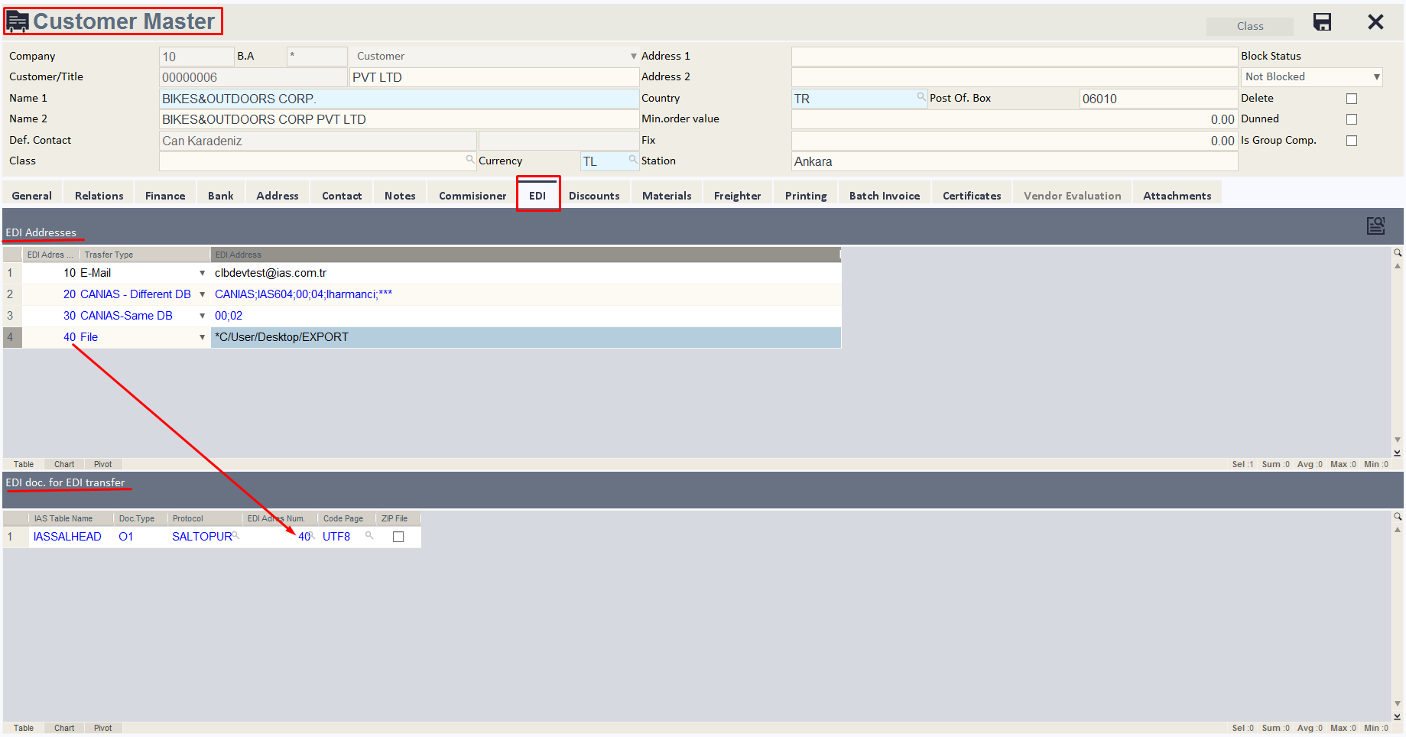

Slide 24
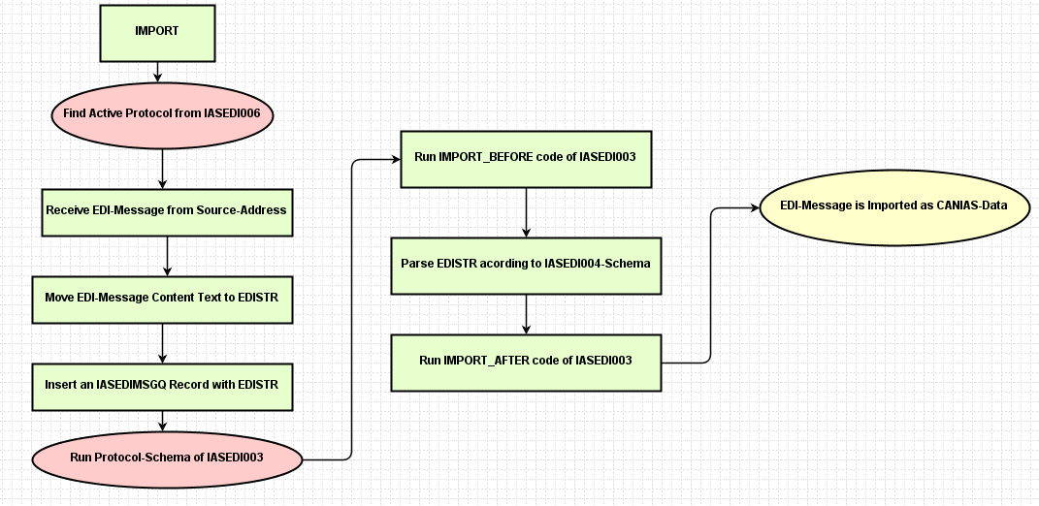
10. Import before/after code Working Principle Diagram

Slide 25
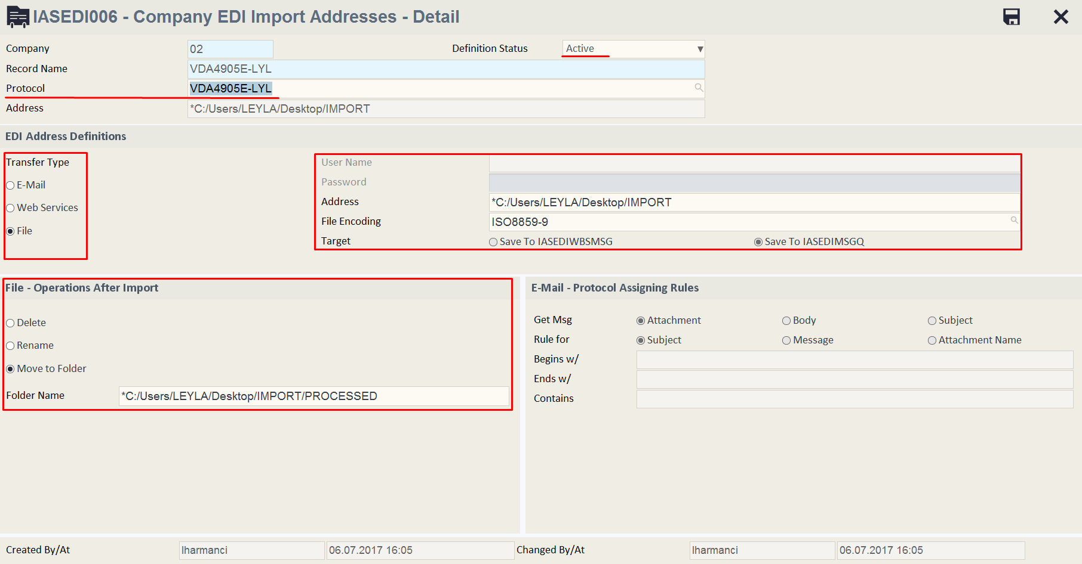
10. IASEDI006 – (Company EDI Import Addresses)

Slide 26
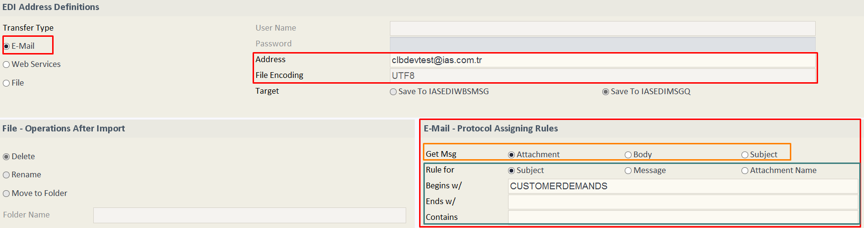
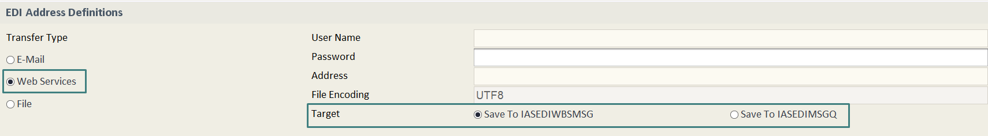

Slide 27
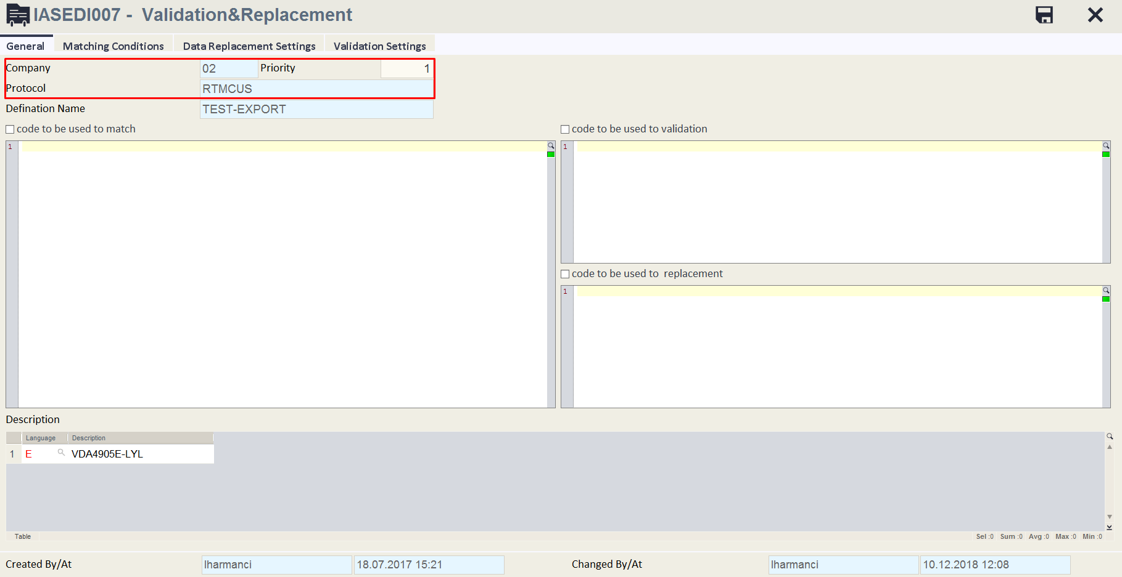
11. IASEDI007 - EDI Validation & Replacement

Slide 28
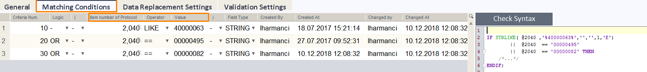
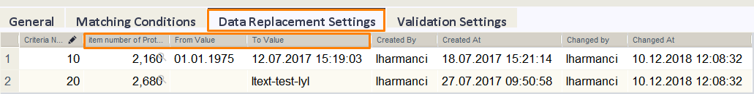
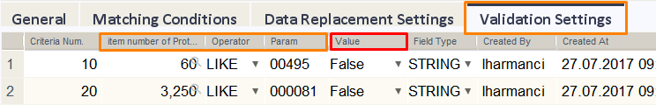

Slide 29
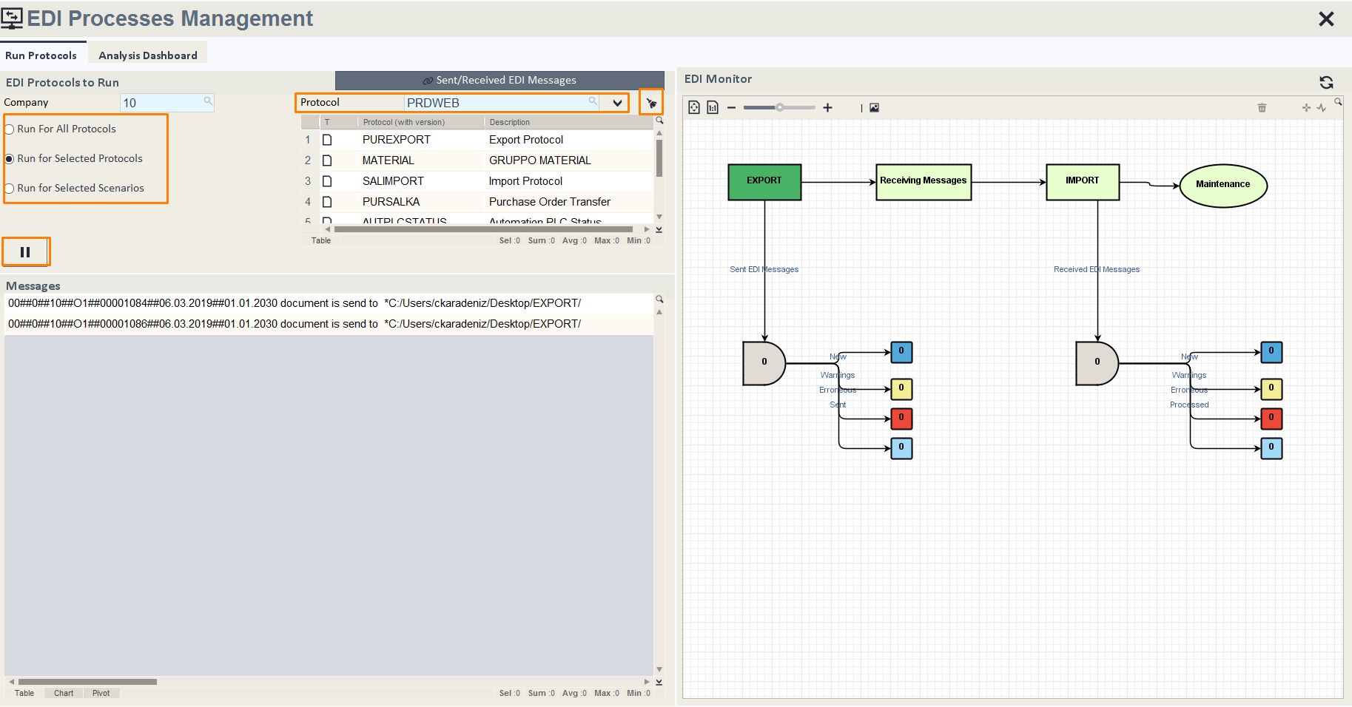
12. EDIT100 – EDI Processes Management

Slide 30
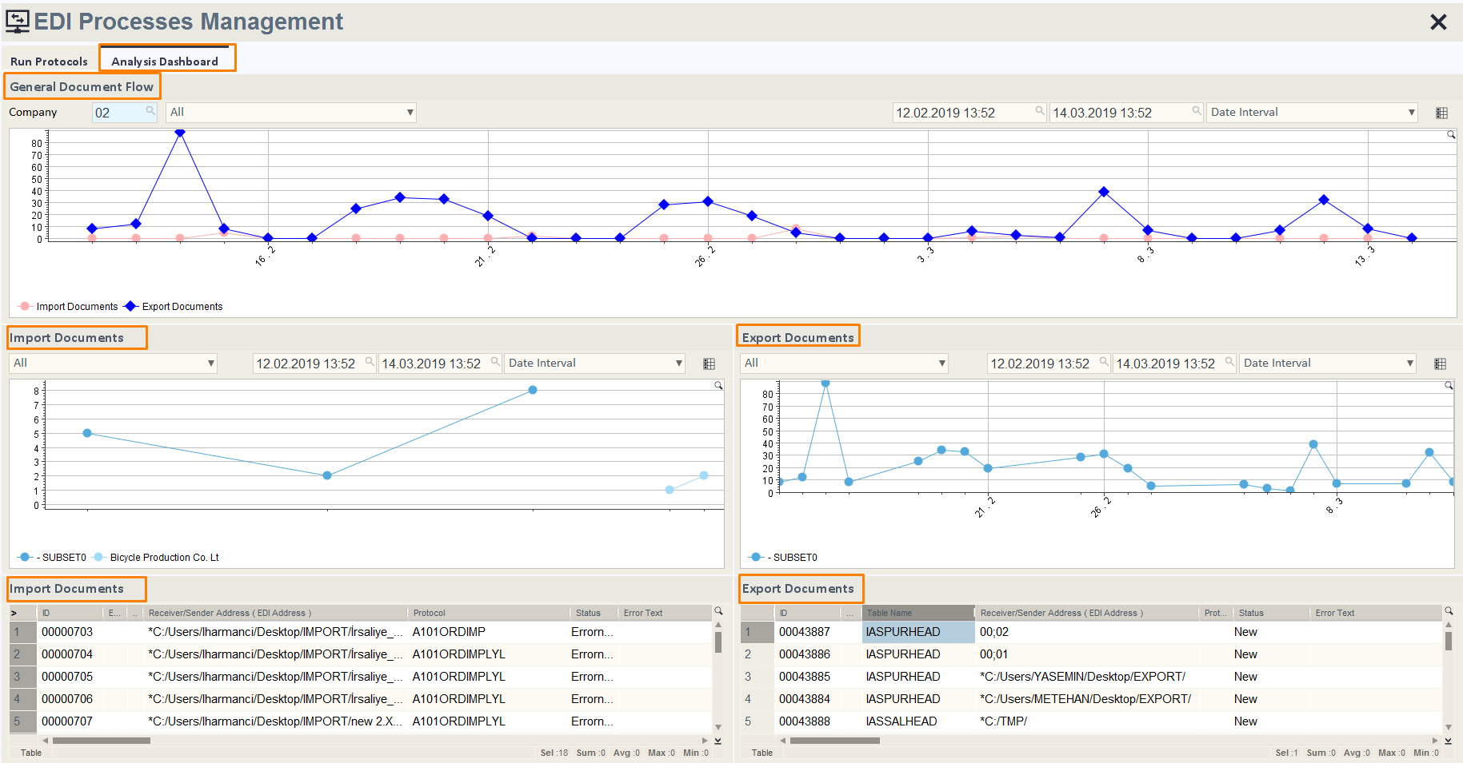

Slide 31
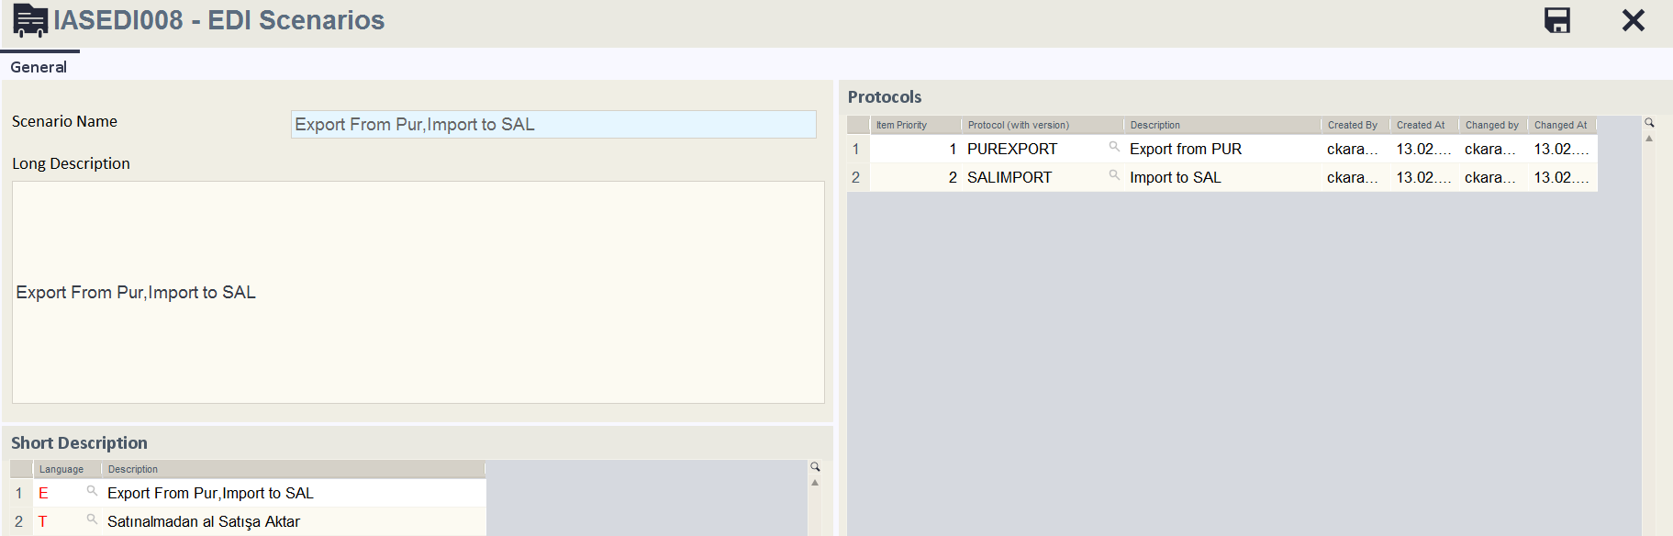
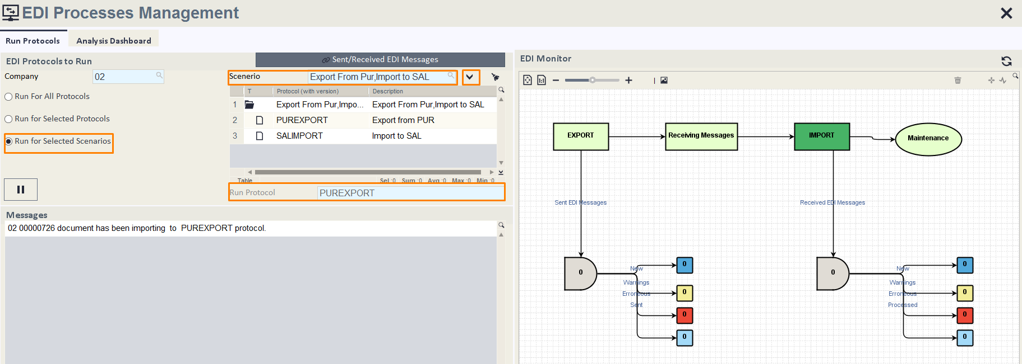
13. EDIT100 – EDI Scenarios Definition & Run

Slide 32
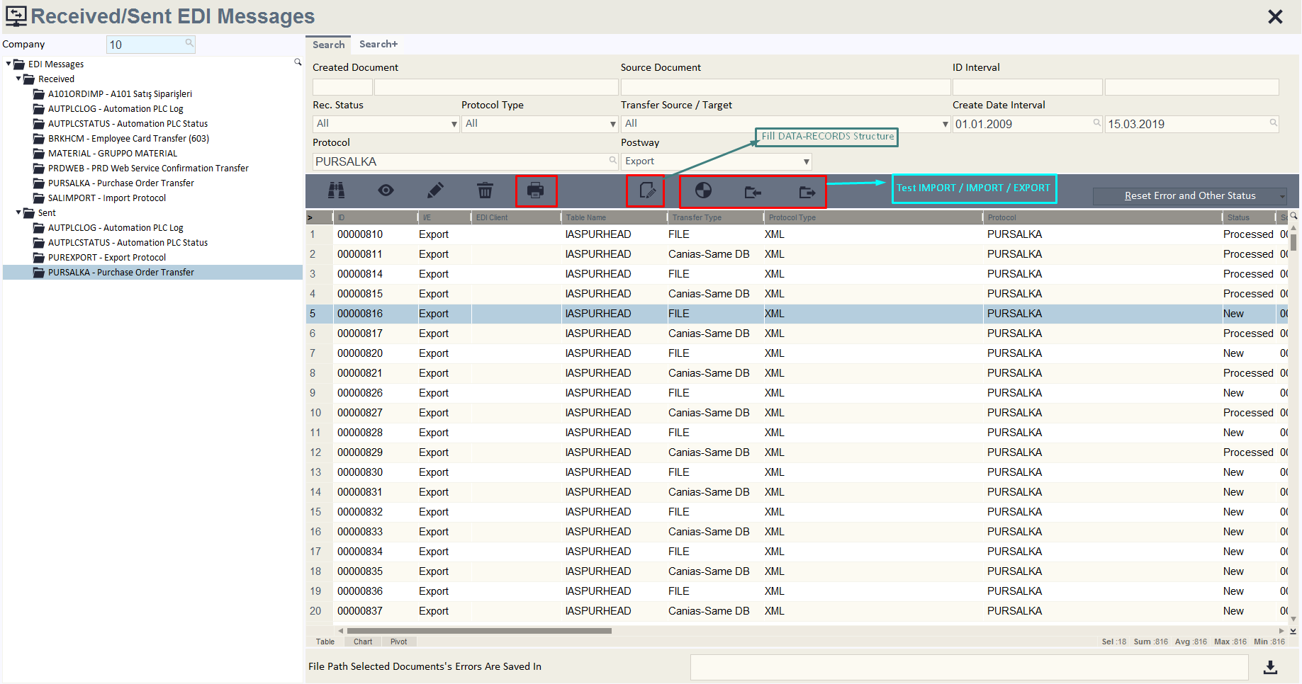
14. EDIT101 – Received/Sent EDI Messages

Slide 33
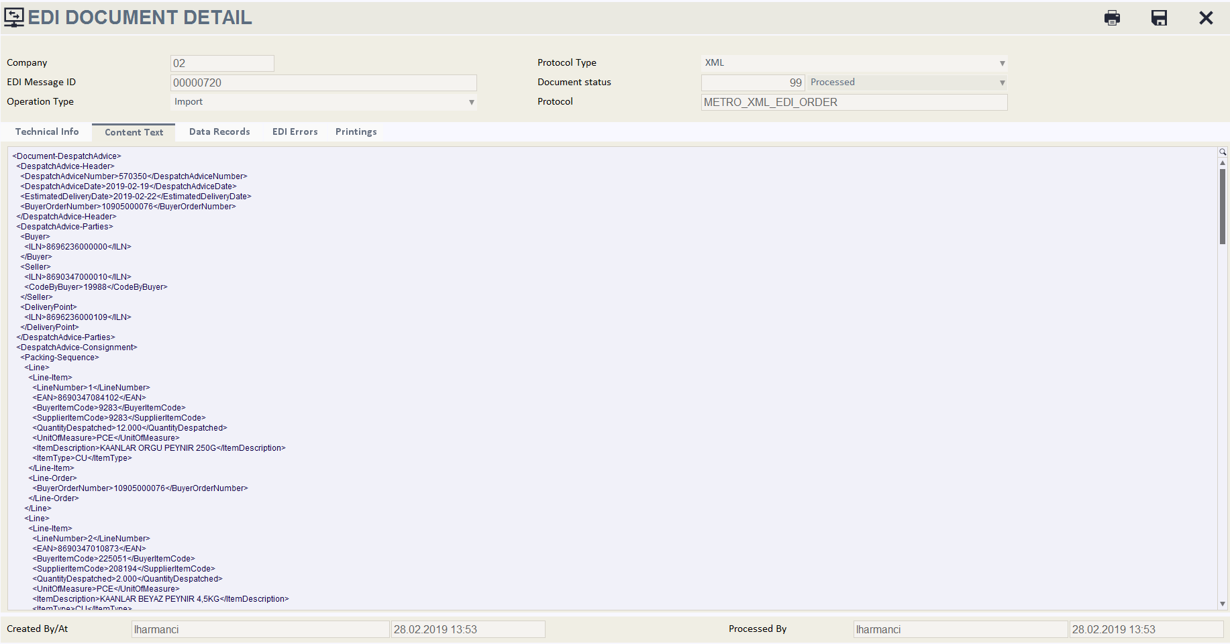

Slide 34
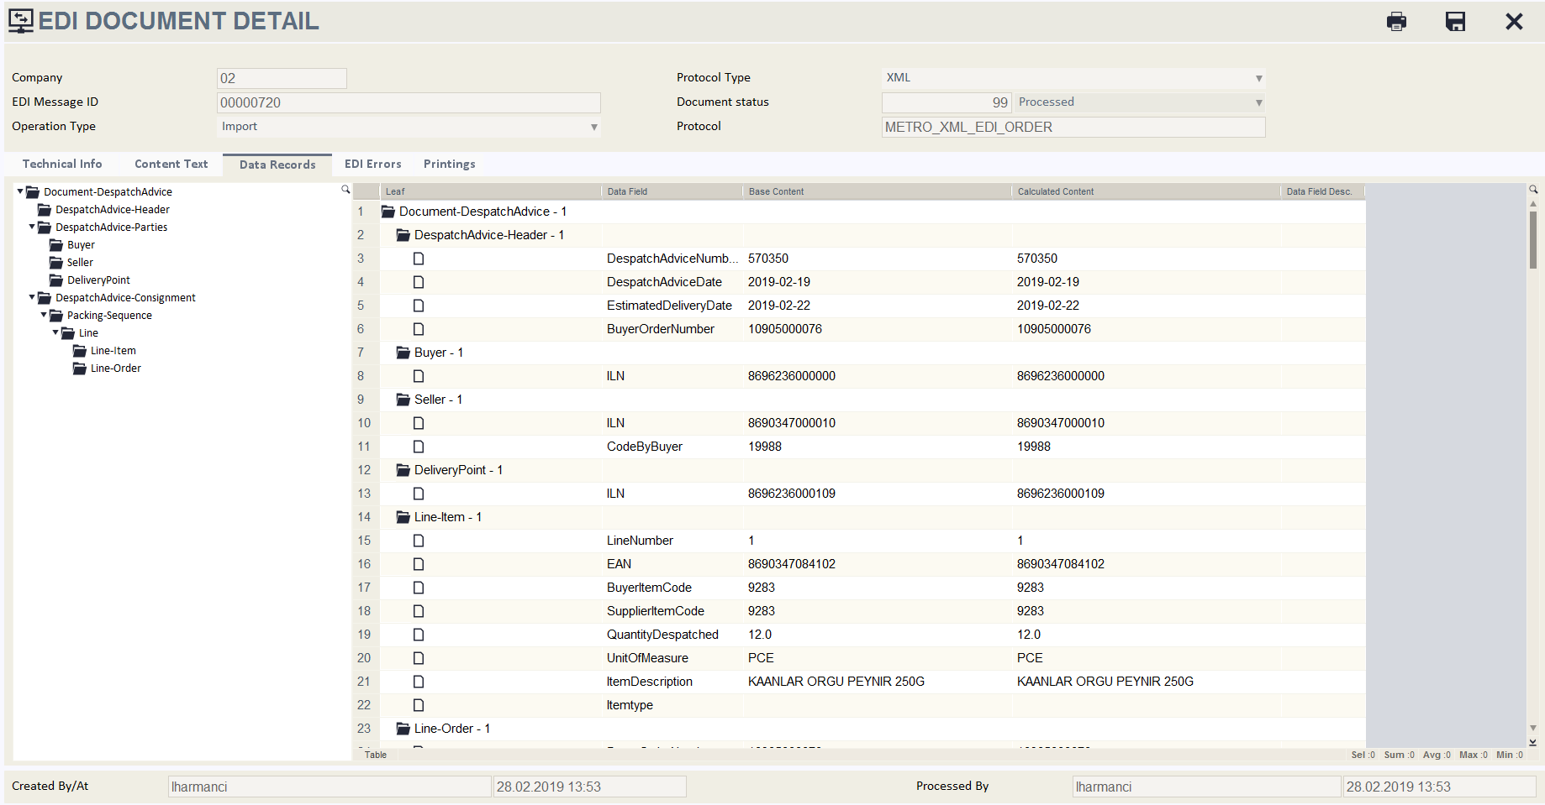

Slide 35
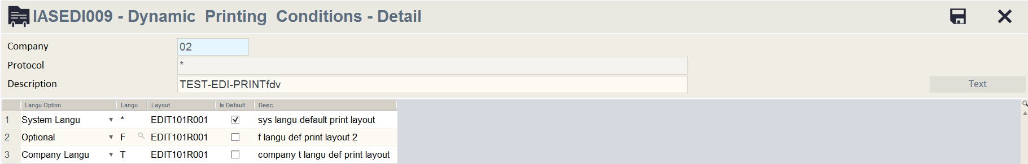
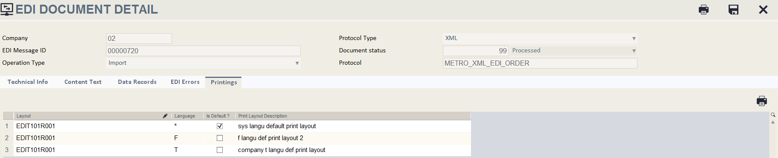

Slide 36
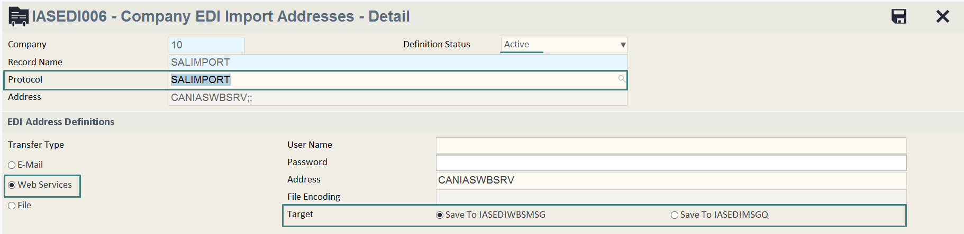
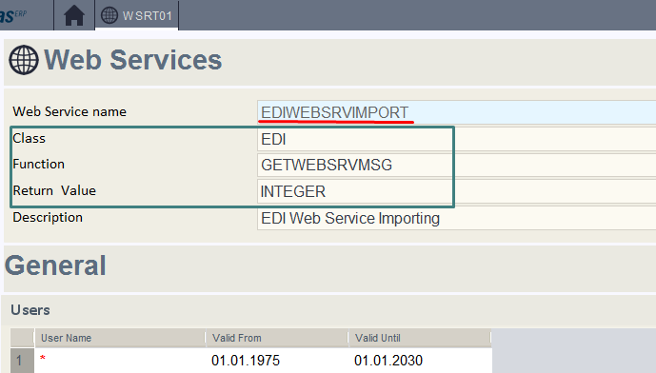
15. EDI-EDIWEBSRVIMPORT EDI Web Service Importing

Slide 37
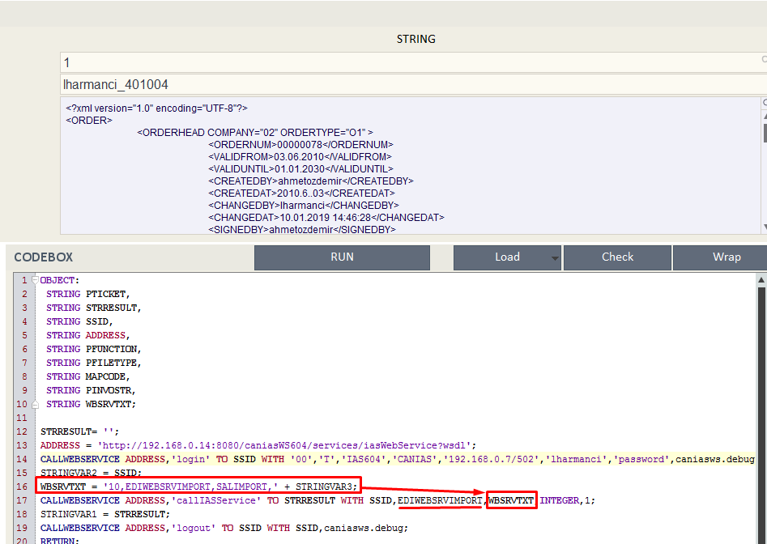

Slide 38

THANKS…

